Slide 1
Shortest path
wisnu ananta kusuma
ananta@apps.ipb.ac.id
Disarikan dari berbagai sumber

Slide 2
Shortest Path Problems
How can we find the shortest route between two points on a road map?
Model the problem as a graph problem:
Road map is a weighted graph:
vertices = cities
edges = road segments between cities
edge weights = road distances
Goal: find a shortest path between two vertices (cities)

Slide 3
Shortest Path Problem
Input:
Directed graph G = (V, E)
Weight function w : E → R
Weight of path p = ⟨v₀, v₁, . . . , v_{k}⟩
Shortest-path weight from u to v:
δ(u, v) = min w(p) : u v if there exists a path from u to v
∞ otherwise
Note: there might be multiple shortest paths from u to v
t
x
3
6
9
3
4
s
0
2
1
2
7
5
3
5
11
6
y
z
p

Slide 4
Variants of Shortest Path
Single-source shortest paths
G = (V, E) ⇒ find a shortest path from a given source vertex s to each vertex v ∈ V
Single-destination shortest paths
Find a shortest path to a given destination vertex t from each vertex v
Reversing the direction of each edge ⇒ single-source

Slide 5
Variants of Shortest Paths (cont’d)
Single-pair shortest path
Find a shortest path from u to v for given vertices u and v
All-pairs shortest-paths
Find a shortest path from u to v for every pair of vertices u and v

Slide 6
Negative-Weight Edges
Negative-weight edges may form negative-weight cycles
If such cycles are reachable from
the source, then δ(s, v) is not properly
defined!
Keep going around the cycle, and get
w(s, v) = - ∞ for all v on the cycle
a
b
-4
3
4
c
6
d
g
s
0
5
8
y
-3
2
3
7
e
-6
f

Slide 7
Negative-Weight Edges
s → a: only one path
δ(s, a) = w(s, a) = 3
s → b: only one path
δ(s, b) = w(s, a) + w(a, b) = -1
s → c: infinitely many paths
⟨s, c⟩, ⟨s, c, d, c⟩, ⟨s, c, d, c, d, c⟩
cycle has positive weight (6 - 3 = 3)
⟨s, c⟩ is shortest path with weight δ(s, b) = w(s, c) = 5
a
b
3
-4
-1
3
4
c
6
d
g
s
0
5
5
11
8
-∞
y
-3
2
3
7
-∞
-∞
e
-6
f

Slide 8
Negative-Weight Edges
s → e: infinitely many paths:
⟨s, e⟩, ⟨s, e, f, e⟩, ⟨s, e, f, e, f, e⟩
cycle ⟨e, f, e⟩ has negative weight:
3 + (- 6) = -3
can find paths from s to e with arbitrarily large negative weights
δ(s, e) = - ∞ ⇒ no shortest path exists between s and e
Similarly: δ(s, f) = - ∞, δ(s, g) = - ∞
a
b
3
-4
-1
3
4
c
6
d
g
s
0
5
5
11
8
-∞
y
-3
2
3
7
-∞
-∞
e
-6
f
h
i
∞
2
∞
h, i, j not
reachable
from s
-8
3
∞
j
δ(s, h) = δ(s, i) = δ(s, j) = ∞

Slide 9
Cycles
Can shortest paths contain cycles?
Negative-weight cycles
Shortest path is not well defined
Positive-weight cycles:
By removing the cycle, we can get a shorter path
Zero-weight cycles
No reason to use them
Can remove them to obtain a path with same weight
No!
No!

Slide 10
Optimal Substructure Theorem
Given:
A weighted, directed graph G = (V, E)
A weight function w: E → R,
A shortest path p = ⟨v₁, v₂, . . . , v_{k}⟩ from v₁ to v_{k}
A subpath of p: p_{ij} = ⟨v_{i}, v_{i+1}, . . . , v_{j}⟩, with 1 ≤ i ≤ j ≤ k
Then: p_{ij} is a shortest path from v_{i} to v_{j}
Proof: p = v₁ v_{i} v_{j} v_{k}
w(p) = w(p_{1i}) + w(p_{ij}) + w(p_{jk})
Assume ∃ p_{ij}’ from v_{i} to v_{j} with w(p_{ij}’) < w(p_{ij})
⇒ w(p’) = w(p_{1i}) + w(p_{ij}’) + w(p_{jk}) < w(p) contradiction!
v_{j}
p_{ij}
p_{jk}
v₁
p_{1i}
p_{ij}’
v_{k}
v_{i}
p_{1i}
p_{ij}
p_{jk}

Slide 11
Triangle Inequality
For all (u, v) ∈ E, we have:
δ (s, v) ≤ δ (s, u) + δ (u, v)
- If u is on the shortest path to v we have the equality sign
s
u
v
s
u
v

Slide 12
Algorithms
Bellman-Ford algorithm
Negative weights are allowed
Negative cycles reachable from the source are not allowed.
Dijkstra’s algorithm
Negative weights are not allowed
Operations common in both algorithms:
Initialization
Relaxation

Slide 13
Shortest-Paths Notation
For each vertex v ∈ V:
δ(s, v): shortest-path weight
d[v]: shortest-path weight estimate
Initially, d[v]=∞
d[v]→δ(s,v) as algorithm progresses
π[v] = predecessor of v on a shortest path from s
If no predecessor, π[v] = NIL
π induces a tree—shortest-path tree
t
x
3
6
9
3
4
s
0
2
1
2
7
5
3
5
11
6
y
z

Slide 14
Initialization
Alg.: INITIALIZE-SINGLE-SOURCE(V, s)
for each v ∈ V
do d[v] ← ∞
π[v] ← NIL
d[s] ← 0
All the shortest-paths algorithms start with INITIALIZE-SINGLE-SOURCE

Slide 15
Relaxation Step
Relaxing an edge (u, v) = testing whether we can improve the shortest path to v found so far by going through u
If d[v] > d[u] + w(u, v)
we can improve the shortest path to v
⇒ d[v]=d[u]+w(u,v)
⇒ π[v] ← u
After relaxation:
d[v] ≤ d[u] + w(u, v)
s
s
u
v
u
v
5
2
9
5
2
6
RELAX(u, v, w)
RELAX(u, v, w)
u
v
u
v
5
2
7
5
2
6
no change

Slide 16
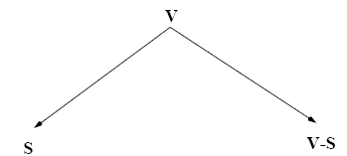
Dijkstra’s Algorithm
Single-source shortest path problem:
No negative-weight edges: w(u, v) > 0, ∀ (u, v) ∈ E
Each edge is relaxed only once!
Maintains two sets of vertices:
d[v]=δ (s, v)
d[v]>δ (s, v)

Slide 17
Dijkstra’s Algorithm (cont.)
Vertices in V – S reside in a min-priority queue
Keys in Q are estimates of shortest-path weights d[u]
Repeatedly select a vertex u ∈ V – S, with the minimum shortest-path estimate d[u]
Relax all edges leaving u

Slide 18
Dijkstra (G, w, s)
S=<> Q=<s,t,x,z,y>
S=<s>
Q=<y,t,x,z>
t
1
x
t
x
∞
∞
1
∞
∞
10
10
9
10
9
s
0
2
3
4
6
2
3
4
6
s
0
5
7
7
5
∞
∞
∞
∞
2
5
2
y
z
y
z

Slide 19
Example (cont.)
t
1
x
t
1
x
10
∞
8
14
8
14
13
10
9
10
9
s
0
2
3
4
6
s
0
2
3
4
6
5
7
5
7
5
∞
5
7
7
2
2
y
z
y
z
S=<s,y> Q=<z,t,x>
S=<s,y,z> Q=<t,x>

Slide 20
Example (cont.)
S=<s,y,z,t> Q=<x>
S=<s,y,z,t,x> Q=<>
t
x
t
1
x
1
8
9
8
13
9
10
9
10
9
2
3
4
6
s
0
2
3
4
6
s
0
5
7
5
7
5
7
5
7
2
2
y
z
y
z

Slide 21
Dijkstra (G, w, s)
INITIALIZE-SINGLE-SOURCE(V, s)
S ← ∅
Q ← V[G]
while Q ≠ ∅
do u ← EXTRACT-MIN(Q)
S ← S ∪ {u}
for each vertex v ∈ Adj[u]
do RELAX(u, v, w)
Update Q (DECREASE_KEY)
Running time: O(VlgV + ElgV) = O(ElgV)
Θ(V)
O(V) build min-heap
Executed O(V) times
O(lgV)
O(VlgV)
O(E) times
(total)
O(ElgV)
O(lgV)

Slide 22
Binary Heap vs Fibonacci Heap
Running time depends on the implementation of the heap

Slide 23
Bellman-Ford Algorithm
Single-source shortest path problem
Computes δ(s, v) and π[v] for all v ∈ V
Allows negative edge weights - can detect negative cycles.
Returns TRUE if no negative-weight cycles are reachable from the source s
Returns FALSE otherwise ⇒ no solution exists

Slide 24
Bellman-Ford Algorithm (cont’d)
Idea:
Each edge is relaxed |V–1| times by making |V-1| passes over the whole edge set.
To make sure that each edge is relaxed exactly |V – 1| times, it puts the edges in an unordered list and goes over the list |V – 1| times.
t
5
x
∞
∞
6
-2
(t, x), (t, y), (t, z), (x, t), (y, x), (y, z), (z, x), (z, s), (s, t), (s, y)
-3
s
0
8
7
-4
7
2
∞
∞
9
y
z

Slide 25
BELLMAN-FORD(V, E, w, s)
t
5
x
Pass 1
t
5
x
∞
∞
∞
∞
6
6
-2
6
-2
-3
-3
0
8
7
s
0
8
7
s
-4
-4
7
2
7
2
∞
∞
∞
∞
7
9
9
y
z
y
z
E: (t, x), (t, y), (t, z), (x, t), (y, x), (y, z), (z, x), (z, s), (s, t), (s, y)

Slide 26
Example
(t, x), (t, y), (t, z), (x, t), (y, x), (y, z), (z, x), (z, s), (s, t), (s, y)
t
5
x
t
x
Pass 1
(from
previous
slide)
Pass 2
5
6
∞
6
∞
4
11
6
-2
6
-2
-3
-3
s
0
8
7
8
7
s
0
-4
-4
7
2
7
2
7
∞
7
∞
9
2
y
z
9
y
z
Pass 3
t
5
x
Pass 4
t
5
x
6
∞
6
∞
2
4
11
2
4
11
6
-2
6
-2
-3
-3
s
0
8
7
0
8
7
s
-4
-4
7
2
7
2
7
∞
7
∞
2
2
9
9
-2
y
z
y
z

Slide 27
Detecting Negative Cycles (perform extra test after V-1 iterations)
for each edge (u, v) ∈ E
do if d[v] > d[u] + w(u, v)
then return FALSE
return TRUE
s
b
0
2
∞
-8
3
∞
c
1st pass
2nd pass
s
b
s
b
Look at edge (s, b):
d[b] = -1
d[s] + w(s, b) = -4
⇒ d[b] > d[s] + w(s, b)
0
2
∞
-3
2
2
-3
2
-6
-1
-8
3
-8
3
∞
5
5
2
c
c
(s,b) (b,c) (c,s)

Slide 28
BELLMAN-FORD(V, E, w, s)
INITIALIZE-SINGLE-SOURCE(V, s)
for i ← 1 to |V| - 1
do for each edge (u, v) ∈ E
do RELAX(u, v, w)
for each edge (u, v) ∈ E
do if d[v] > d[u] + w(u, v)
then return FALSE
return TRUE
Running time: O(V+VE+E)=O(VE)
Θ(V)
O(V)
O(VE)
O(E)
O(E)

Slide 29
All-Pairs Shortest Paths
Given:
Directed graph G = (V, E)
Weight function w : E → R
Compute:
The shortest paths between all pairs of vertices in a graph
Result: an n × n matrix of shortest-path distances δ(u, v)
2
3
4
1
8
3
2
-4
1
-5
7
5
4
6

Slide 30
Masalah: All Pairs Shortest Path
Problem instance: Suatu graf G yang setiap sisinya mempunyai bobot
Tentukan shortest path untuk setiap pasangan vertex dalam G
Generalisasi dari masalah single source shortest path yang bisa diselesaikan dengan algoritme Dijkstra

Slide 31
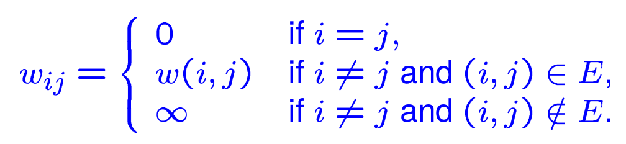
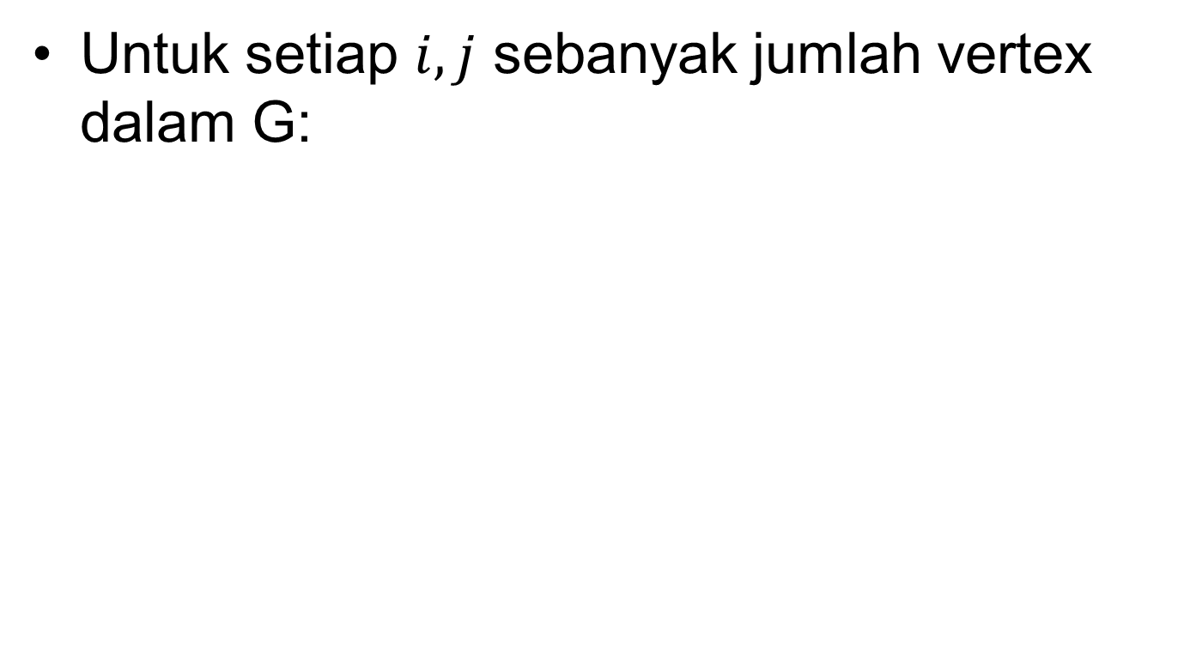
Struktur Adjacency Matrix
Untuk setiap $i,j$sebanyak jumlah vertex dalam G:

Slide 32
Contoh Adjancency Matrix
Untuk graph berarah (directed)
 | 1 | 2 | 3 | 4 | 5
1 | 0 | 3 | 8 | ∞ | -4
2 | ∞ | 0 | ∞ | 1 | 7
3 | ∞ | 4 | 0 | ∞ | ∞
4 | 2 | ∞ | -3 | 0 | ∞
5 | ∞ | ∞ | ∞ | 6 | 0
2
3
4
1
3
2
8
-3
1
-4
7
5
4
6

Slide 33
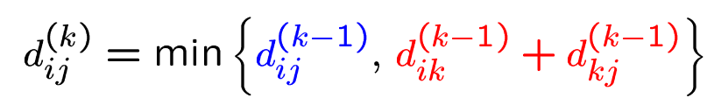
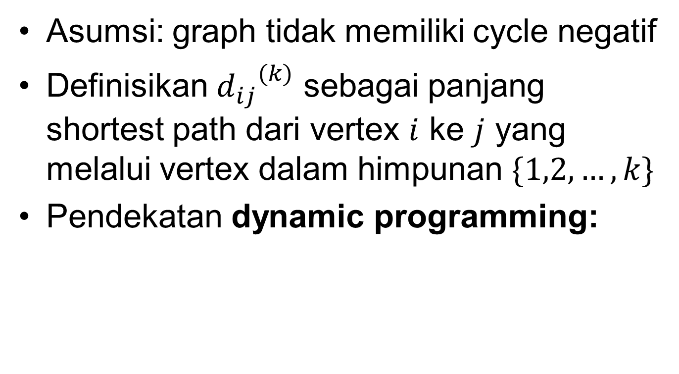
Algoritme Floyd-Warshall
Asumsi: graph tidak memiliki cycle negatif
Definisikan ${d_{ij}}^{(k)}$ sebagai panjang shortest path dari vertex $i$ ke $j$ yang melalui vertex dalam himpunan $\{1,2,…,k\}$
Pendekatan dynamic programming:

Slide 34
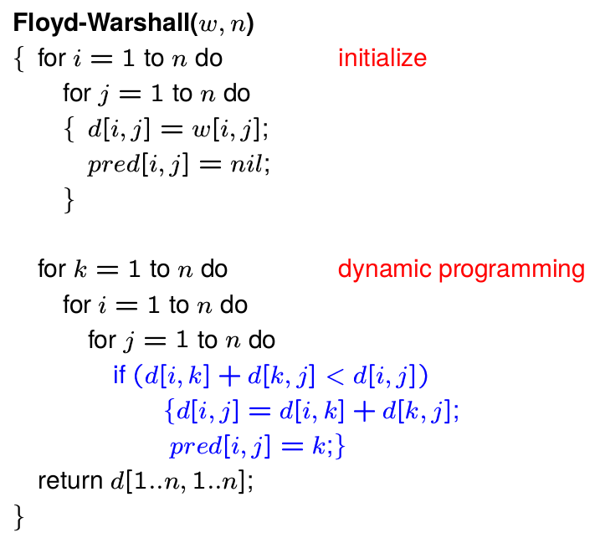
pred[i,j] digunakan untuk merekonstruksi shortest path-nya

Slide 35
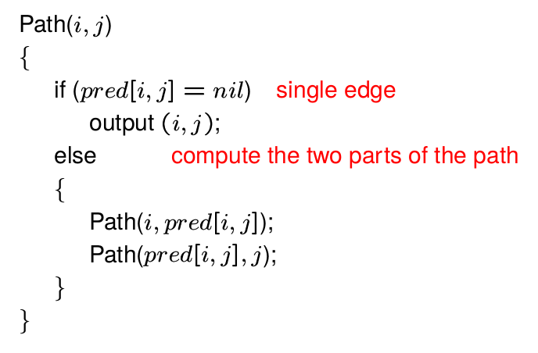
Rekonstruksi Shortest Path

Slide 36
Contoh
Inisialisasi
 | 1 | 2 | 3 | 4
1 | 0 | 3 | 8 | ∞
2 | ∞ | 0 | ∞ | 1
3 | ∞ | 4 | 0 | ∞
4 | 2 | ∞ | -3 | 0
2
3
4
d
1
3
2
8
-3
1
 | 1 | 2 | 3 | 4
1 | - | - | - | -
2 | - | - | - | -
3 | - | - | - | -
4 | - | - | - | -
4
pred

Slide 37
Contoh
k = 1
i | j
1 | 1 | d(1,1) + d(1,1) !< d(1,1) → no update
 | 2 | d(1,1) + d(1,2) !< d(1,2) → no update
 | 3 | d(1,1) + d(1,3) !< d(1,3) → no update
 | 4 | d(1,1) + d(1,4) !< d(1,4) → no update
2 | 1 | d(2,1) + d(1,1) !< d(2,1) → no update
 | 2 | d(2,1) + d(1,2) !< d(2,2) → no update
 | 3 | d(2,1) + d(1,3) !< d(2,3) → no update
 | 4 | d(2,1) + d(1,4) !< d(2,4) → no update
3 | 1 | d(3,1) + d(1,1) !< d(3,1) → no update
 | 2 | d(3,1) + d(1,2) !< d(3,2) → no update
 | 3 | d(3,1) + d(1,3) !< d(3,3) → no update
 | 4 | d(3,1) + d(1,4) !< d(3,4) → no update
4 | 1 | d(4,1) + d(1,1) !< d(4,1) → no update
 | 2 | d(4,1) + d(1,2) < d(4,2) → d(4,2) = d(4,1) + d(1,2) = 5
 | 3 | d(4,1) + d(1,3) !< d(4,3) → no update
 | 4 | d(4,1) + d(1,4) !< d(4,4) → no update
 | 1 | 2 | 3 | 4
1 | 0 | 3 | 8 | ∞
2 | ∞ | 0 | ∞ | 1
3 | ∞ | 4 | 0 | ∞
4 | 2 | 5 | -3 | 0
d
 | 1 | 2 | 3 | 4
1 | - | - | - | -
2 | - | - | - | -
3 | - | - | - | -
4 | - | 1 | - | -
pred

Slide 38
Contoh
k = 2
i | j
1 | 1 | d(1,2) + d(2,1) !< d(1,1) → no update
 | 2 | d(1,2) + d(2,2) !< d(1,2) → no update
 | 3 | d(1,2) + d(2,3) !< d(1,3) → no update
 | 4 | d(1,2) + d(2,4) < d(1,4) → d(1,4) = d(1,2) + d(2,4) = 4
2 | 1 | d(2,2) + d(2,1) !< d(2,1) → no update
 | 2 | d(2,2) + d(2,2) !< d(2,2) → no update
 | 3 | d(2,2) + d(2,3) !< d(2,3) → no update
 | 4 | d(2,2) + d(2,4) !< d(2,4) → no update
3 | 1 | d(3,2) + d(2,1) !< d(3,1) → no update
 | 2 | d(3,2) + d(2,2) !< d(3,2) → no update
 | 3 | d(3,2) + d(2,3) !< d(3,3) → no update
 | 4 | d(3,2) + d(2,4) < d(3,4) → d(3,4) = d(3,2) + d(2,4) = 5
4 | 1 | d(4,2) + d(2,1) !< d(4,1) → no update
 | 2 | d(4,2) + d(2,2) !< d(4,2) → no update
 | 3 | d(4,2) + d(2,3) !< d(4,3) → no update
 | 4 | d(4,2) + d(2,4) !< d(4,4) → no update
 | 1 | 2 | 3 | 4
1 | 0 | 3 | 8 | 4
2 | ∞ | 0 | ∞ | 1
3 | ∞ | 4 | 0 | 5
4 | 2 | 5 | -3 | 0
d
 | 1 | 2 | 3 | 4
1 | - | - | - | 2
2 | - | - | - | -
3 | - | - | - | 2
4 | - | 1 | - | -
pred

Slide 39
Contoh
k = 3
i | j
1 | 1 | d(1,3) + d(3,1) !< d(1,1) → no update
 | 2 | d(1,3) + d(3,2) !< d(1,2) → no update
 | 3 | d(1,3) + d(3,3) !< d(1,3) → no update
 | 4 | d(1,3) + d(3,4) !< d(1,4) → no update
2 | 1 | d(2,3) + d(3,1) !< d(2,1) → no update
 | 2 | d(2,3) + d(3,2) !< d(2,2) → no update
 | 3 | d(2,3) + d(3,3) !< d(2,3) → no update
 | 4 | d(2,3) + d(3,4) !< d(2,4) → no update
3 | 1 | d(3,3) + d(3,1) !< d(3,1) → no update
 | 2 | d(3,3) + d(3,2) !< d(3,2) → no update
 | 3 | d(3,3) + d(3,3) !< d(3,3) → no update
 | 4 | d(3,3) + d(3,4) !< d(3,4) → no update
4 | 1 | d(4,3) + d(3,1) !< d(4,1) → no update
 | 2 | d(4,3) + d(3,2) < d(4,2) → d(4,2) = d(4,3) + d(3,2) = 1
 | 3 | d(4,3) + d(3,3) !< d(4,3) → no update
 | 4 | d(4,3) + d(3,4) !< d(4,4) → no update
 | 1 | 2 | 3 | 4
1 | 0 | 3 | 8 | 4
2 | ∞ | 0 | ∞ | 1
3 | ∞ | 4 | 0 | 5
4 | 2 | 1 | -3 | 0
d
 | 1 | 2 | 3 | 4
1 | - | - | - | 2
2 | - | - | - | -
3 | - | - | - | 2
4 | - | 3 | - | -
pred

Slide 40
Contoh
k = 4
i | j
1 | 1 | d(1,4) + d(4,1) !< d(1,1) → no update
 | 2 | d(1,4) + d(4,2) !< d(1,2) → no update
 | 3 | d(1,4) + d(4,3) < d(1,3) → d(1,3) = d(1,4) + d(4,3) = 1
 | 4 | d(1,4) + d(4,4) !< d(1,4) → no update
2 | 1 | d(2,4) + d(4,1) < d(2,1) → d(2,1) = d(2,4) + d(4,1) = 3
 | 2 | d(2,4) + d(4,2) !< d(2,2) → no update
 | 3 | d(2,4) + d(4,3) < d(2,3) → d(2,3) = d(2,4) + d(4,3) = -2
 | 4 | d(2,4) + d(4,4) !< d(2,4) → no update
3 | 1 | d(3,4) + d(4,1) < d(3,1) → d(3,1) = d(3,4) + d(4,1) = 7
 | 2 | d(3,4) + d(4,2) !< d(3,2) → no update
 | 3 | d(3,4) + d(4,3) !< d(3,3) → no update
 | 4 | d(3,4) + d(4,4) !< d(3,4) → no update
4 | 1 | d(4,4) + d(4,1) !< d(4,1) → no update
 | 2 | d(4,4) + d(4,2) !< d(4,2) → no update
 | 3 | d(4,4) + d(4,3) !< d(4,3) → no update
 | 4 | d(4,4) + d(4,4) !< d(4,4) → no update
 | 1 | 2 | 3 | 4
1 | 0 | 3 | 1 | 4
2 | 3 | 0 | -2 | 1
3 | 7 | 4 | 0 | 5
4 | 2 | 1 | -3 | 0
d
 | 1 | 2 | 3 | 4
1 | - | - | 4 | 2
2 | 4 | - | 4 | -
3 | 4 | - | - | 2
4 | - | 3 | - | -
pred

Slide 41
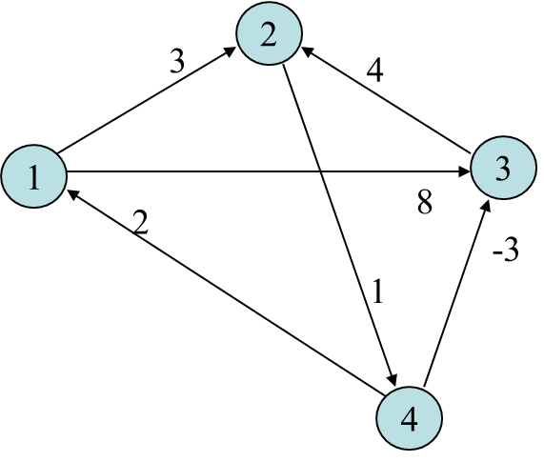
Contoh
Rekonstruksi path dari 3 → 1 (jarak = 7)
3,...,1 pred(3,1) = 4
3,…,4,…,1 pred(3,4) = 2
3,…,2,…,4,…,1 pred(3,2) = null → output(3,2)
3,2,…,4,…,1 pred(2,4) = null → output(2,4)
3,2,4,…,1 pred(4,1) = null → output(4,1)
3,2,4,1
Path = 3 – 2 – 4 – 1
 | 1 | 2 | 3 | 4
1 | - | - | 4 | 2
2 | 4 | - | 4 | -
3 | 4 | - | - | 2
4 | - | 3 | - | -
pred

Slide 42
Aplikasi real shortest path
DNA Sequence Assemby
Belum ada sequencer yang bisa membaca genom secara keseluruhan
Maka dilakukan shotgun sequencing, yaitu dengan mengkloning (mengcopy) library kemudian dibaca oleh sekuenser. Pembacaan ini analoginya seperti genom yang utuh dipotong-potong secara random
Hasilnya berupa fragmen atau reads yang jumlahnya jutaan dan memiliki overlap dengan fragmen/read yang lain. Fragmen ini ukurannya pendek.
Sebagai ilustrasi, misal genom utuh panjangnya 1 juta Bp (setara dengan 1 Megabyte), sedangkan fragmen panjangnya antara 200-400 bp (setara dengan 200-400 byte)
Fragmen-fragmen ini dapat diperlakukan seperti string dengan panjang tertentu (relatif sangat pendek dibandingkan dengan panjang genom utuhnya
Untuk menghasilkan genom yang utuh fragmen-fragmen itu harus di-assembly (dirakit/disambung kembali) – bagaimana caranya ?
Hal ini dapat diformulasikan sebagai masalah shortest common superstring

Slide 43
Aplikasi real shortest path
Soal
Permasalahan di atas dapat dimodelkan dengan graf. Definisikan apa yang menjadi node apa yang menjadi edge
Jelaskan kenapa permasalahan di atas dapat digolongkan sebagai Hamiltonian path problem? (Tergolong NP complete)
Fikirkan definisi node dan edge yang baru sehingga representasi graf yang baru ini mampu mentransformasikan permasalahan Hamiltonian Path menjadi Eulerian path
Selanjutnya terapkan algoritme All-pairs shortest path

Slide 44
Hamiltonian path (or traceable path) is a path in an undirected or directed graph that visits each vertex exactly once.
Eulerian path is a trail in a finite graph which visits every edge exactly once.

Slide 45


